Slide 1
CLASS SYLLABUS
2021-22 - Health Education – Mr. consiglio
#HealthIsAHabit

Slide 2
STUDENT/PARENT-TEACHER COMMUNICATION
For fasTest response, CONTACT ME VIA:
email
Kindly allow hours for me to respond:
24
wconsiglio@yonkerspublicschools.org

Slide 3
students need 3 simple EVERYDAY SUPPLIES:
1 pen/pencil
1 two-pocket “Health ONLY” folder
1 single-subject notebook (or section of notebook/binder dedicated to) Health class ONLY!

Slide 4
Remind ME – WE WILL!
Correct due dates for assignments are posted via remind! we will use THE remind SYSTEM to remind students if they have (most) homework due sometime soon!
2021-22 school year: to access your class' code, visit, https://www.yonkerspublicschools.org/Page/45098

Slide 5
Class info
Most class content will be available on 1 of 2 places:
1) class page (see link below)
2) students' Microsoft Teams account

Slide 6
OUR ESSENTIAL QUESTION OF THE YEAR!
Does a SPECIFIC health behavior positively or negatively influence my current health status?
Example: Does vaping help – or hurt – my health status?

Slide 7
Grading policy
Quarterly Breakdown
(subject to change as appropriate):
Major Assessments (tests, projects, etc.): 33%
Minor Assessments (quizzes, homework, etc.): 33%
Classroom-based assignments & Participation: 33%

Slide 8
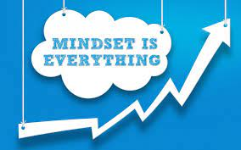
Class mottoS
The 2 quotes we will reference most this year are:
a) “Health is a habit”
b) “if you stay ready, you won’t have to get ready.”

Slide 9
Late work = …………..
How may classes late can you submit your work? 1*
*Late work will not be accepted the final week of the quarter, unless permission is granted.
How many points can you still obtain?
½ or more - just do it!

Slide 10
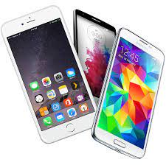
Cell phones, unless directed otherwise, are not allowed in class. No exceptions.

Slide 11
*PARENTS – PLEASE COMPLETE THE INFO BELOW!* Parent/GUARDIAN NameS: p/g phone(s): p/g email address(es):
*P/G SIGNATURE X

Slide 12
Student name
I have read all of the information included & had the opportunity to ask mr. consiglio any questions that i may have.
Student signature x

